Slide 1
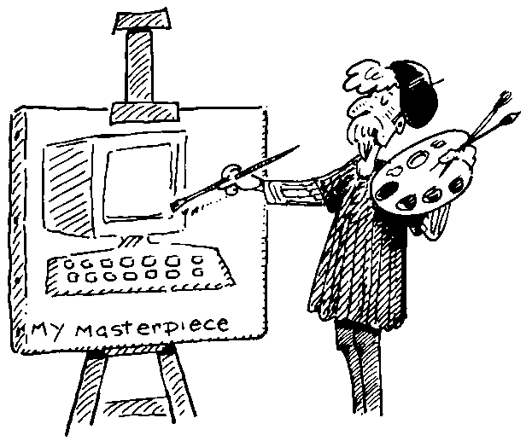
Understanding Users

Slide 2
Know the User - User Model
Representation of the users of a system
Models to aid design - User profiling - create a simple UM
Part of requirements elicitation
User centred design must involve users
User profiling helps identify users

Slide 3
Know the User?
Know your audience
Who will be using the product?
Age - Tastes - Expectations - Experience
Gender - Job -
Education - use of language
What constraints do these things impose?
How will it affect design?

Slide 4
Usage
Know your environment - where?
Home use
Factory use
Internet or network use
School - College - University
Viewed and controlled by a single person?
Projected or viewed on screen
Time of day
How often - how long for
What constraints will these impose

Slide 5
Environment
Noisy - interfere with sound - concentration
Quiet - library or classroom
Very bright - outdoors - unpredictable
Very dark
Projected at times (need to set different colours)
Used on laptop?

Slide 6
Technology
How long will the product be usable before it
needs an upgrade (information)
hardware change makes it obsolete
Does the project need managing once it is released?
Maintenance
Bug fixing
Updates

Slide 7
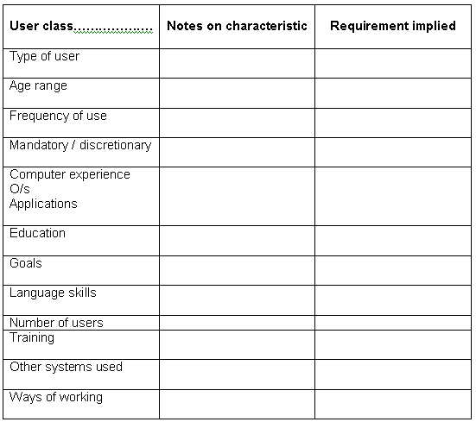

Slide 8
Why do we need to understand users?
Interacting with technology is cognitive
We need to take into account cognitive processes involved and cognitive limitations of users
We can provide knowledge about what users can and cannot be expected to do
Identify and explain the nature and causes of problems users encounter
Supply theories, modelling tools, guidance and methods that can lead to the design of better interactive products

Slide 9
What goes on in the mind?

Slide 10
Core Cognitive aspects
Attention
Perception and recognition
Memory
Reading, speaking and listening
Problem-solving, planning, reasoning and decision-making, learning
Here we focus on attention, perception & recognition, & memory

Slide 11
Attention
Selecting things to concentrate on from the mass around us, at a point in time
Focussed and divided attention enables us to be selective in terms of the mass of competing stimuli but limits our ability to keep track of all events
Information at the interface should be structured to capture users’ attention, e.g. use perceptual boundaries (windows), colour, reverse video, sound and flashing lights

Slide 12
Design implications for attention
Make information relevant when it needs attending to
Use techniques that make things stand out like colour, ordering, spacing, underlining, sequencing and animation
Avoid cluttering the interface - follow the google.com example of crisp, simple design

Slide 13
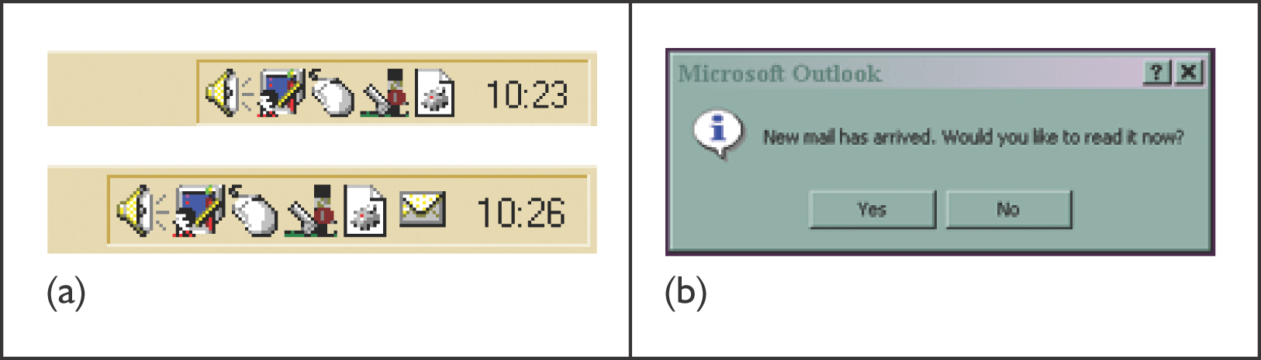
Attracting attention - windows
Unobtrusive display of an envelope (mailbox)
(b) unobtrusive alert signalling the delivery of new mail

Slide 14
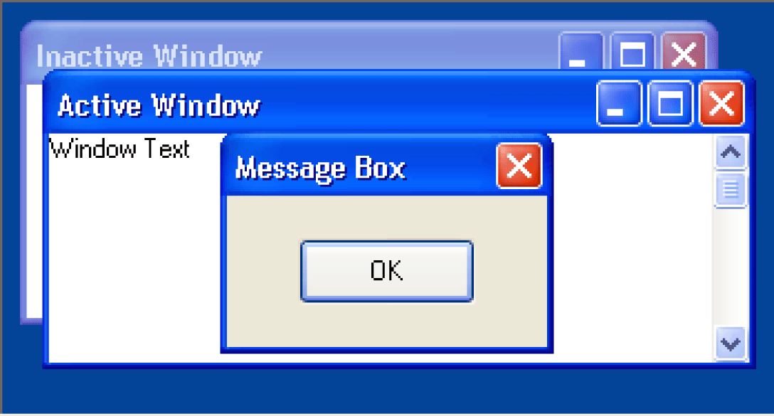
Attracting attention – Windows
Figure 5.31 Microsoft default colours.

Slide 15
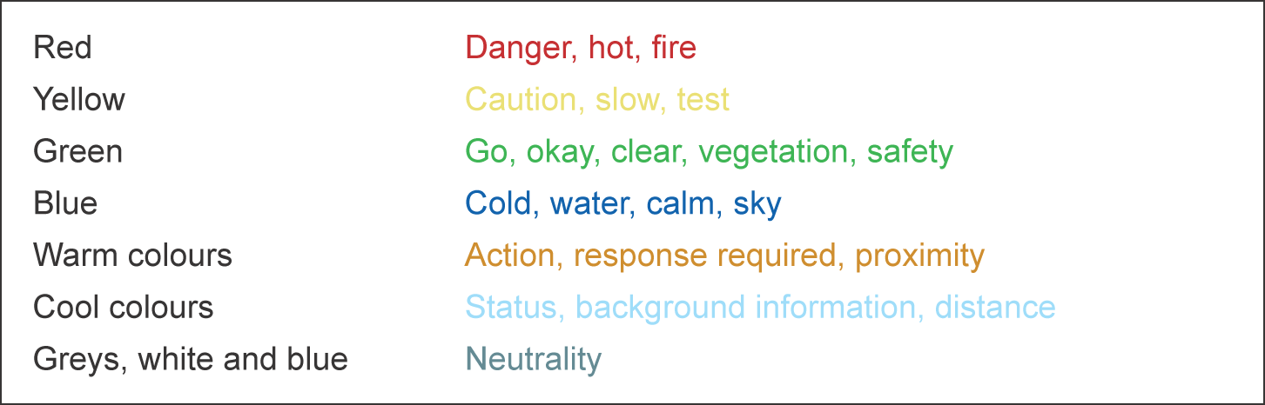
Use colour

Slide 16
Perception and recognition
How information is acquired from the world and transformed into experiences
Obvious implication is to design representations that are readily perceivable, e.g.
Text should be legible
Icons should be easy to distinguish and read

Slide 17
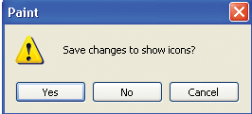
Text legible, buttons evenly spaced

Slide 18

Which is easiest to read and why?
What is the time?
What is the time?
What is the time?
What is the time?
What is the time?

Slide 19
Memory
Involves encoding and recalling knowledge and acting appropriately
We don’t remember everything - involves filtering and processing
Context is important in affecting our memory
We recognize things much better than being able to recall things
The rise of the GUI over command-based interfaces
Better at remembering images than words
The use of icons rather than names

Slide 20
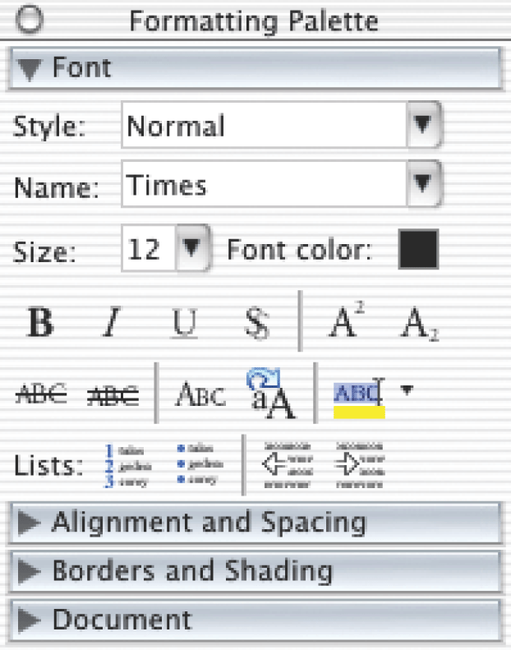
Recall and Recognition – Formatting Palette
How does this work?

Slide 21
More appropriate application of memory research
File management and retrieval is a real problem to most users
Research on information retrieval can be usefully applied
Memory involves 2 processes
recall-directed and recognition-based scanning
File management systems should be designed to optimize both kinds of memory processes

Slide 22
File management
Facilitate existing memory strategies and try to assist users when they get stuck
Help users encode files in richer ways
Provide them with ways of saving files using colour, flagging, image, flexible text, time stamping, etc

Slide 23
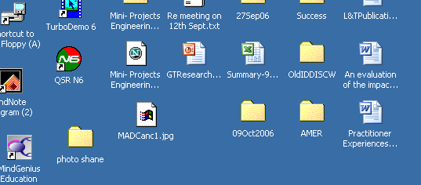
Poor file Management

Slide 24
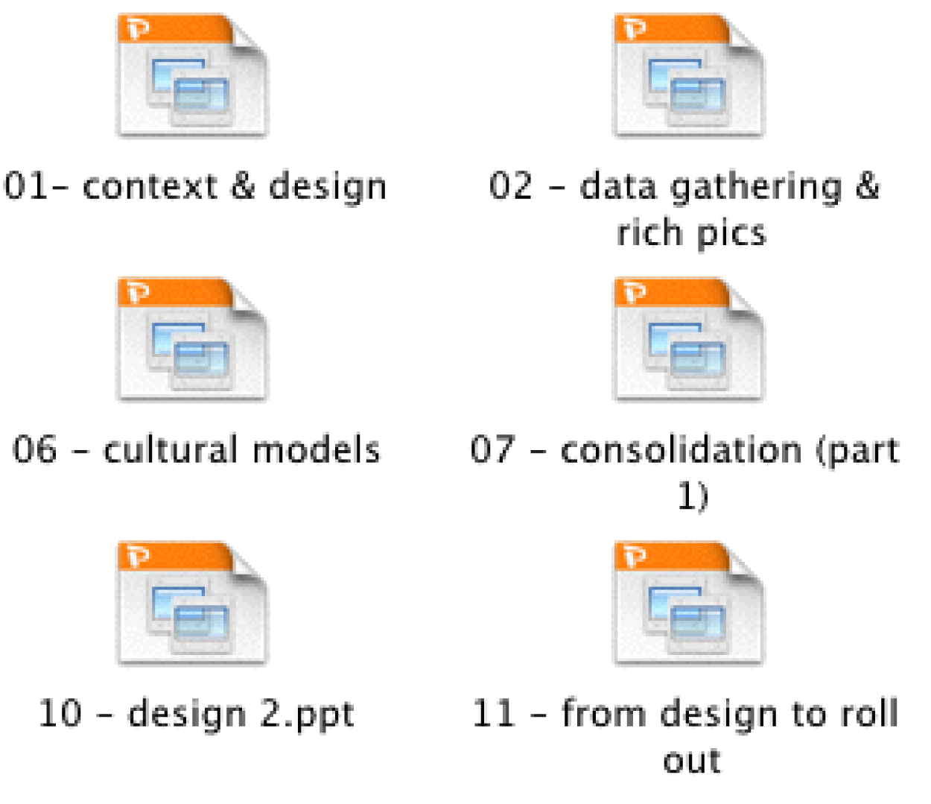
Improved file management

Slide 25
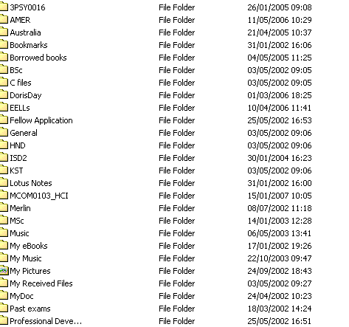
image, flexible text, time stamping

Slide 26
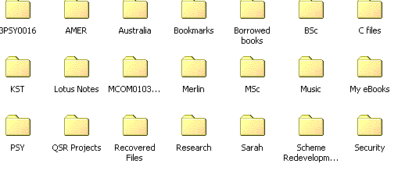
image, flexible text, time stamping - large icon view

